Slide 1

Routing Between VLANs
Medium-Sized Switched Network Construction
© 2007 Cisco Systems, Inc. All rights reserved.
ICND2 v1.0—2-1
The PDF files and any printed representation for this material are the property of Cisco Systems, Inc., for the sole use by Cisco employees for personal study. The files or printed representations may not be used in commercial training, and may not be distributed for purposes other than individual self-study.

Slide 2
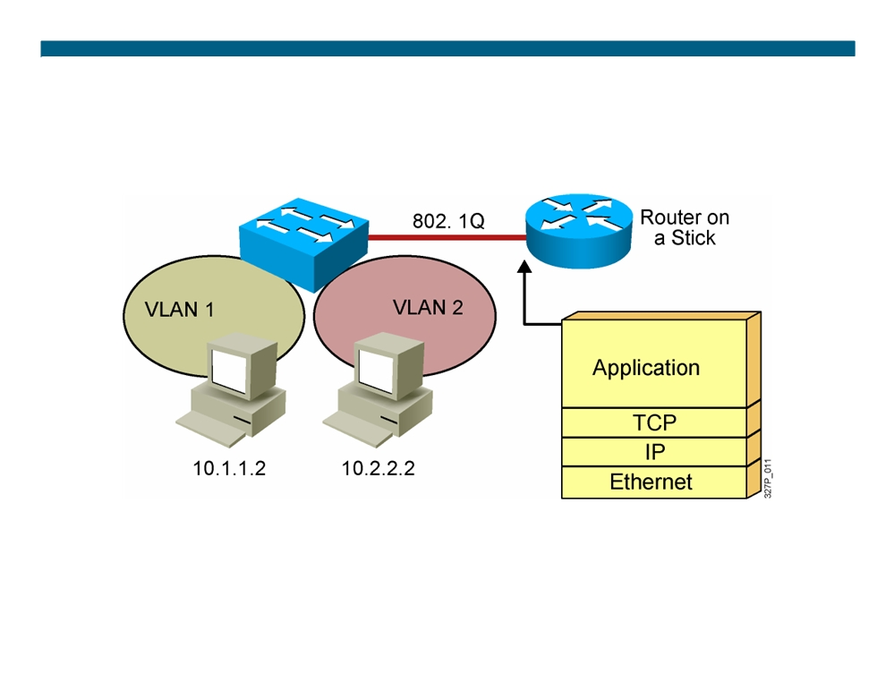
VLAN-to-VLAN Overview
ƒ Network layer devices combine multiple broadcast domains.
© 2007 Cisco Systems, Inc. All rights reserved.
ICND2 v1.0—2-2
The PDF files and any printed representation for this material are the property of Cisco Systems, Inc., for the sole use by Cisco employees for personal study. The files or printed representations may not be used in commercial training, and may not be distributed for purposes other than individual self-study.

Slide 3
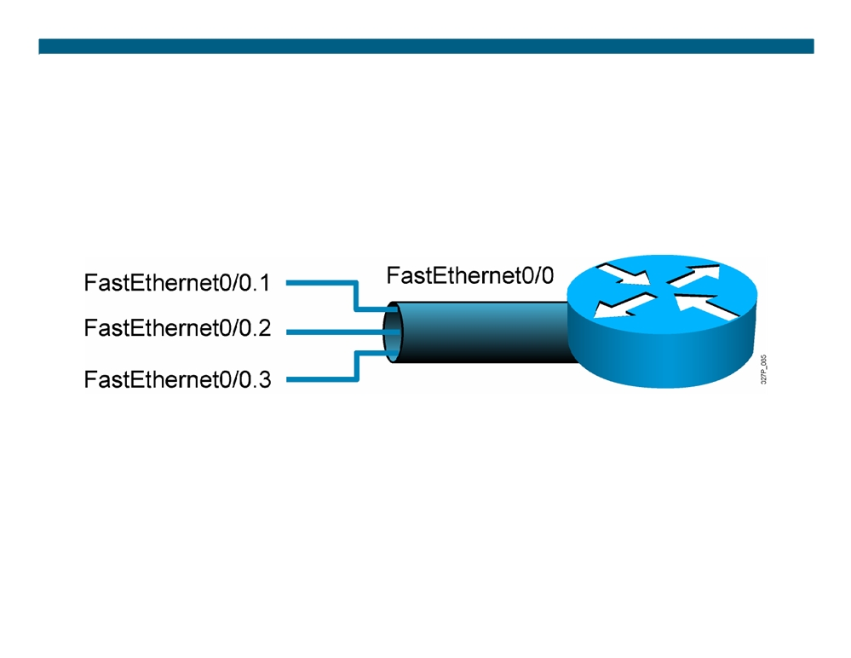
Dividing a Physical Interface into Subinterfaces
ƒ Physical interfaces can be divided into multiple subinterfaces.
© 2007 Cisco Systems, Inc. All rights reserved.
ICND2 v1.0—2-3
The PDF files and any printed representation for this material are the property of Cisco Systems, Inc., for the sole use by Cisco employees for personal study. The files or printed representations may not be used in commercial training, and may not be distributed for purposes other than individual self-study.

Slide 4
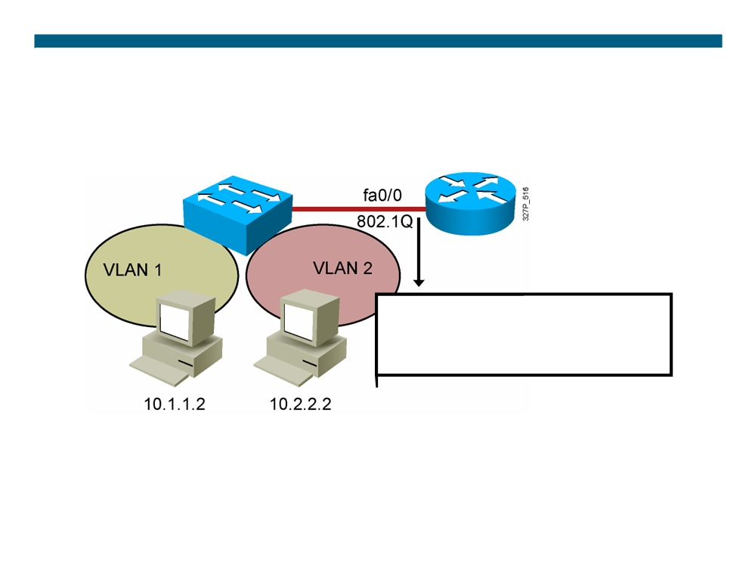
Routing Between VLANs with 802.1Q Trunks
interface fastethernet 0/0 ip address 10.1.1.1 255.255.255.0 interface fastethernet 0/0.2 ip address 10.2.2.1 255.255.255.0 encapsulation dot1q 2
© 2007 Cisco Systems, Inc. All rights reserved.
ICND2 v1.0—2-4
The PDF files and any printed representation for this material are the property of Cisco Systems, Inc., for the sole use by Cisco employees for personal study. The files or printed representations may not be used in commercial training, and may not be distributed for purposes other than individual self-study.

Slide 5
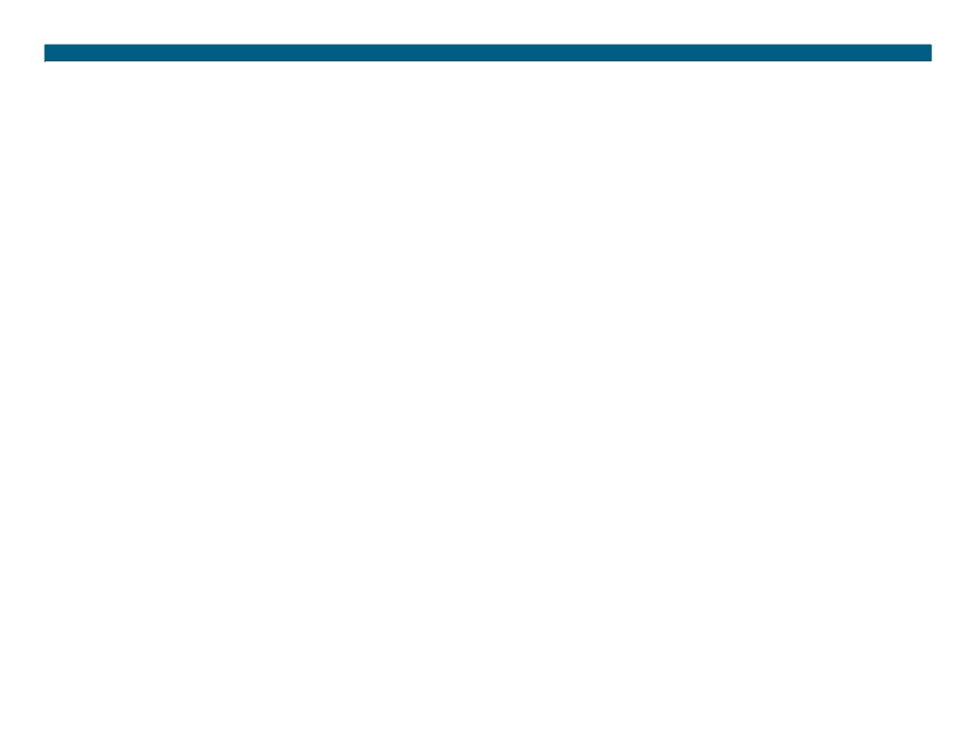
Summary
ƒ Inter-VLAN routing using a router on a stick utilizes an external router to pass traffic between VLANs.
ƒ A router on a stick is configured with a subinterface for each VLAN and 802.1Q trunk encapsulation.
© 2007 Cisco Systems, Inc. All rights reserved.
ICND2 v1.0—2-5
The PDF files and any printed representation for this material are the property of Cisco Systems, Inc., for the sole use by Cisco employees for personal study. The files or printed representations may not be used in commercial training, and may not be distributed for purposes other than individual self-study.

Slide 6
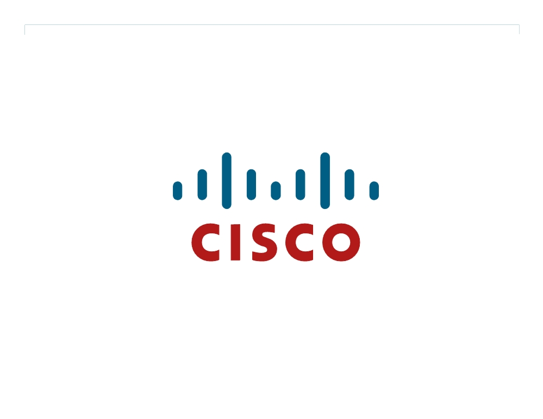
© 2007 Cisco Systems, Inc. All rights reserved.
ICND2 v1.0—2-6 The PDF files and any printed representation for this material are the property of Cisco Systems, Inc., for the sole use by Cisco employees for personal study. The files or printed representations may not be used in commercial training, and may not be distributed for purposes other than individual self-study.

